Slide 1
Setting the record straight

Slide 2

Diabolical abuse of forum

Slide 3
AI can lie

Slide 4
AI can lie
So can colleagues

Slide 5
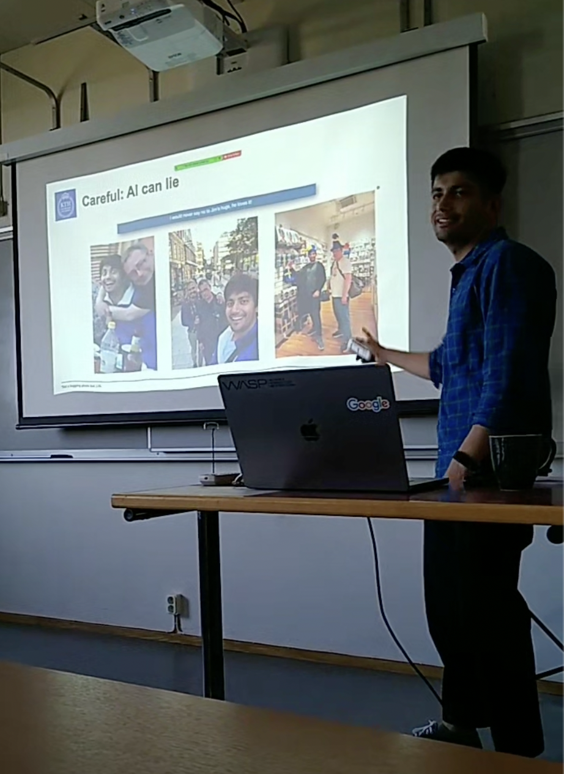
AI can lie
So can colleagues

Slide 6

Truth

